Slide 1
Modeling Dynamic Social Networks —Learning from users, and Prediction
Jie Tang
Department of Computer Science and Technology
Tsinghua University

Slide 2

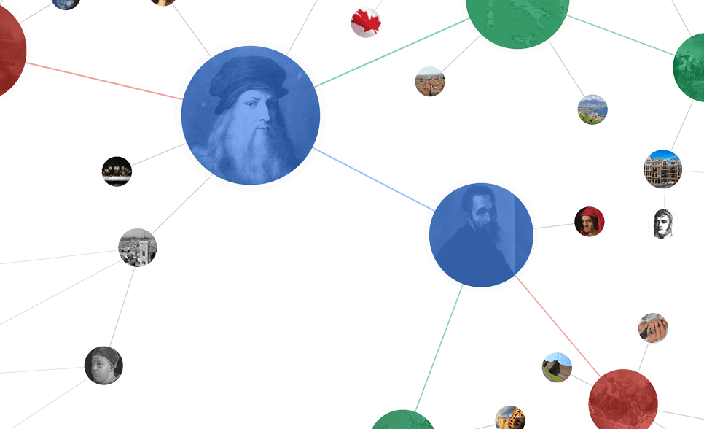






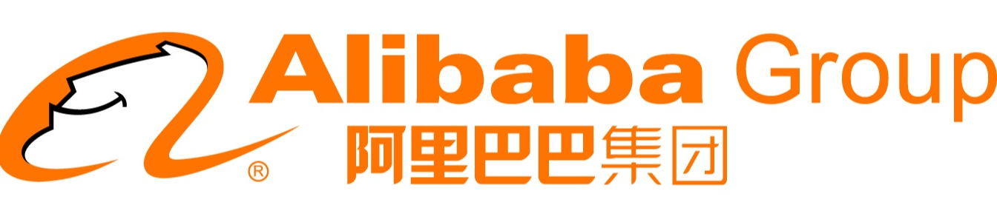
Networked World
1.3 billion users
700 billion minutes/month
280 million users
80% of users are 80-90’s
600 million users
.5 billion tweets/day
560 million users
influencing our daily life
79 million users per month
9.65 billion items/year
800 million users
~50% revenue from network life
500 million users
35 billion on 11/11

Slide 3
15-20 years before…
Web 1.0
?
?
?
+
-
+
?
-
?
+
?
+
-
+
?
-
?
hyperlinks between web pages
Examples:
Google search (information retrieval)

Slide 4

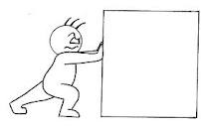

10 years before…
Collaborative Web
?
?
?
-
?
+
+
+
?
-
?
-
+
personalized learning
collaborative filtering

Slide 5
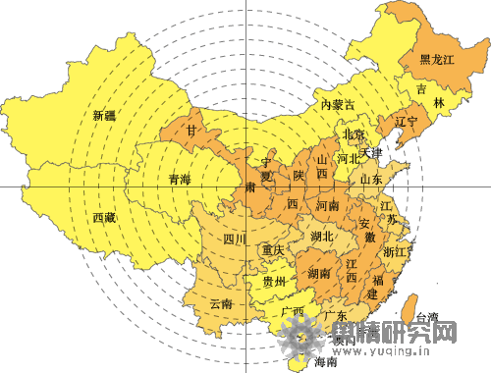
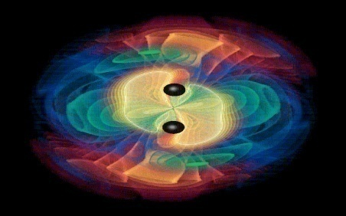
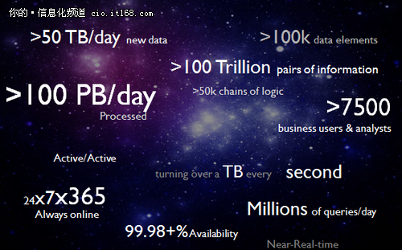
Big Social Analytics—In recent 5 years…
Social Web
Info. Space vs. Social Space
Opinion Mining
Information
Info. Space
Interaction
Innovation diffusion
Knowledge
Social Space
Intelligence
Business intelligence

Slide 6
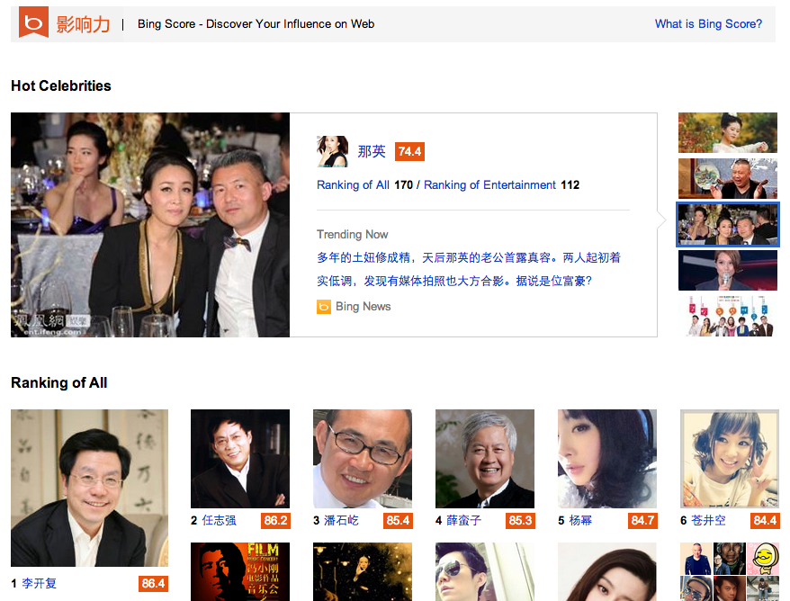
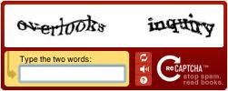


Revolutionary Changes
Social Networks
The Web knows you than yourself:
Contextual computing
Big data marketing
O2O
More …
Human Computation:
reCAPTCHA + OCR
MOOC and xuetangX
Duolingo (Machine Translation)
...
Embedding social in search:
Google plus
FB graph search
Bing’s influence
Education
Search

Slide 7
大(复杂)数据时代
网络趋势
以数据为中心 → 以用户为中心
离线的稀疏网络 → 在线的紧凑网络
大规模数据挖掘 → 大数据的深度分析
技术发展趋势
标准格式内容 → 非标准化内容
关键词的搜索 → 基于语义的搜索
用户行为建模 → 群体智能的用户行为分析
宏观层面分析 → 微观层面分析
…

Slide 8
Core Research in Social Network
Application
Prediction
Search
Information Diffusion
Advertise
Macro
Meso
Micro
Social Network Analysis
Group behavior
User modeling
Erdős-Rényi
Structural hole
Triad
Influence
Social tie
Power-law
Action
Small-world
Community
Theory
Social Theories
Algorithmic Foundations
BIG Social Data

Slide 9
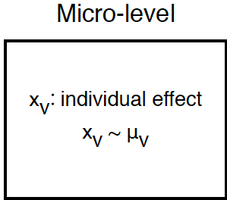
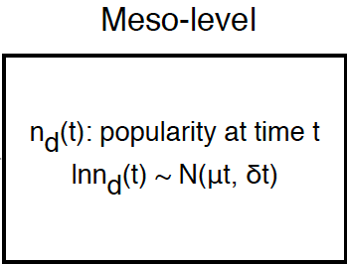
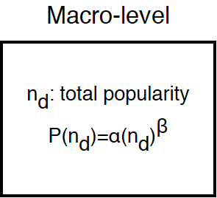
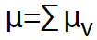
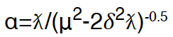
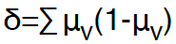
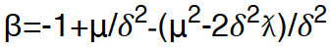
M3DN: A Unified Modeling Framework for Dynamic Social Networks
Binomial
Log-normal
Power law
Notes:
牛顿 大定律 ： 小数据
我们有了关于用户的大数据后，更多的是从不同方面描述关于用户行为的小模型。心理学，决策模型：个人兴趣、朋友、家人、天气

Slide 10
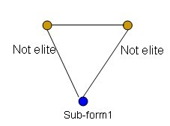
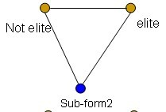
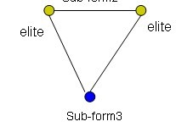
网络用户行为决策
基于三角结构分析的精英用户成长模式
三角结构包含一个目标用户和两个非目标用户，基于非目标用户的组成
模型假设：
成长阶段1：融入社区
成长阶段2：成长为精英用户
成长阶段3：结构洞用户

Slide 11
基于博弈论的用户行为决策建模
Example: a game theory model on Weibo.
Strategy: whether to follow a user or not;
Payoff:
The model has a pure strategy Nash Equilibrium
The value of a user
The density of v’s ego network
The frequency of a user to follow someone
The cost of following a user
Notes:
一名用户的价值（G）正比于其粉丝数，反比于他follow的人的个数
C_2: 关注对象的ego network越密集，说明其粉丝间联系越多，关注这个人越可能吸引更多回粉

Slide 12
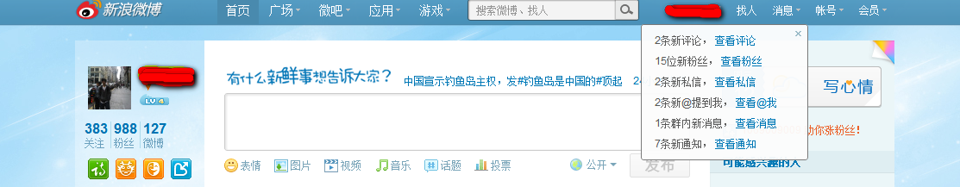
测试案例
在新浪微博上建立一个“机器人”用户
采用上述模型自动关注、发送、及转发微博
现吸引粉丝千人

Slide 13

Roadmap
User-level
Social Tie
Network
tie
Social role
Influence
- Emotion
- Demographics
- Social Influence
- Conformity
- Learning from users
- Learning in social streaming

Slide 14
Interaction between individuals
How do people influence each other?

Slide 15
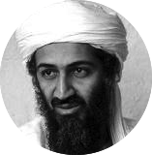






“Love Obama” —social influence in online social networks
I love Obama
I hate Obama, the worst president ever
Obama is fantastic
Obama is great!
No Obama in 2012!
He cannot be the next president!
Positive
Negative
Notes:
Obama has done just that. From social networking to his blog to his Fight the Smears campaign, Obama has made his Web 2.0 presence known. He has over 1.5 million friends on MySpace and Facebook, and he currently has over 28,000,000 followers on Twitter. This personal activity in social networks allows him to quickly get the word out across multiple platforms.

Slide 16
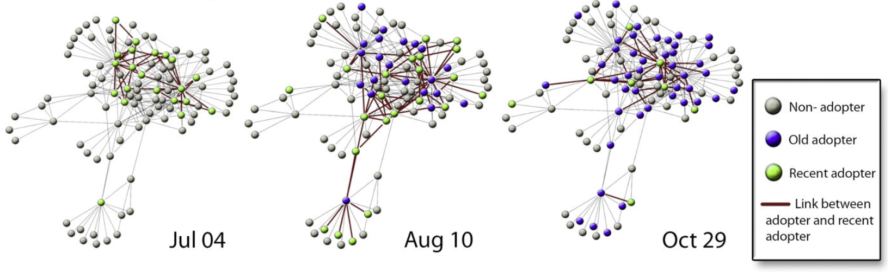
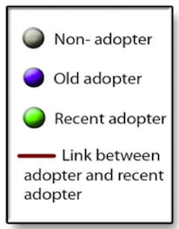
Adoption Diffusion of Y! Go
Yahoo! Go is a product of Yahoo to access its services of search, mailing, photo sharing, etc.
[1] S. Aral, L. Muchnik, and A. Sundararajan. Distinguishing influence-based contagion from homophily-driven diffusion in dynamic networks. PNAS, 106 (51):21544-21549, 2009.
Notes:
Yahoo go started from 2007 and was closed in Jan. 2010

Slide 17

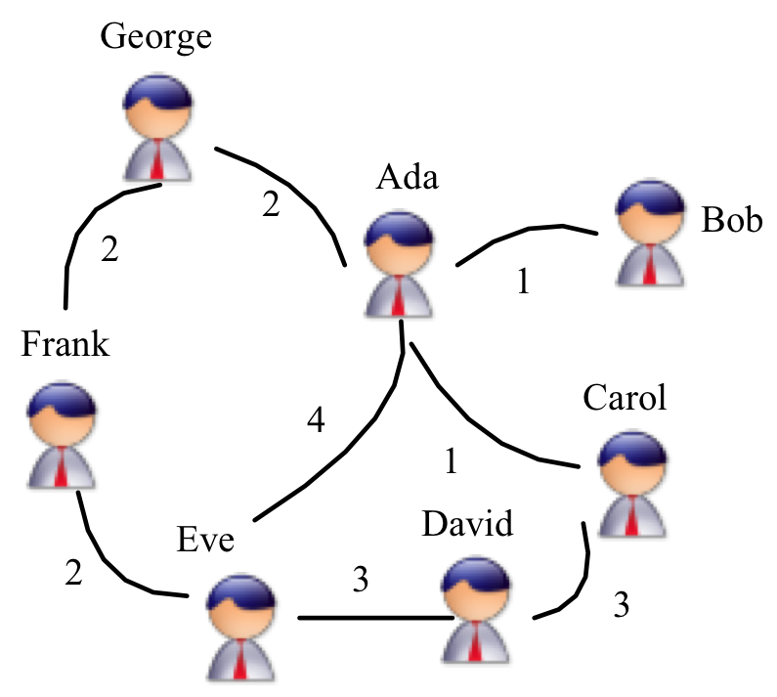

Influence Maximization
Social influence
Who are the opinion leaders in a community?
?
Marketer Alice
Find K nodes (users) in a social network that could maximize the spread of influence (Domingos, 01; Richardson, 02; Kempe, 03)

Slide 18
Influence Maximization
Social influence
Who are the opinion leaders in a community?
?
Marketer Alice
Questions:
- How to quantify the strength of social influence between users?
- How to predict users’ behaviors over time?
Find K nodes (users) in a social network that could maximize the spread of influence (Domingos, 01; Richardson, 02; Kempe, 03)

Slide 19
Topic-based Social Influence Analysis
Social network -> Topical influence network
[1] J. Tang, J. Sun, C. Wang, and Z. Yang. Social Influence Analysis in Large-scale Networks. In KDD’09, pages 807-816, 2009.

Slide 20
The Solution: Topical Affinity Propagation
Basic Idea:
If a user is located in the center of a “DM” community, then he may have strong influence on the other users.
—Homophily theory
Database
Data mining
Data mining
Database
Data mining
Data mining
Database
[1] Jie Tang, Jimeng Sun, Chi Wang, and Zi Yang. Social Influence Analysis in Large-scale Networks. In KDD, pages 807-816, 2009.

Slide 21
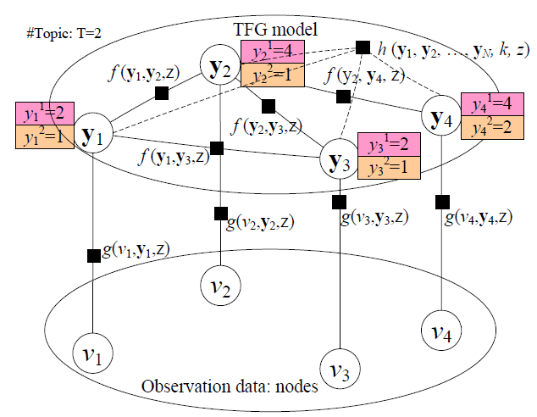
Topical Factor Graph (TFG) Model
Social link
Nodes that have the highest influence on the current node
Node/user
The problem is cast as identifying which node has the highest probability to influence another node on a specific topic along with the edge.

Slide 22
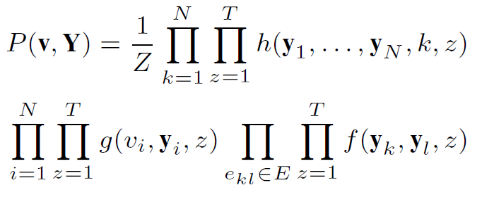
Topical Factor Graph (TFG)
The learning task is to find a configuration for all {y_{i}} to maximize the joint probability.
Objective function:
1. How to define?
2. How to optimize?
Notes:
目标函数P描述了隐变量y_i取任意一组值时的联合概率分布

Slide 23
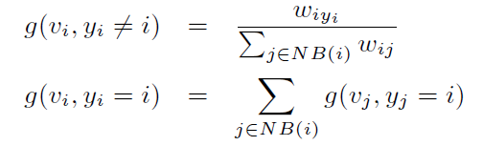
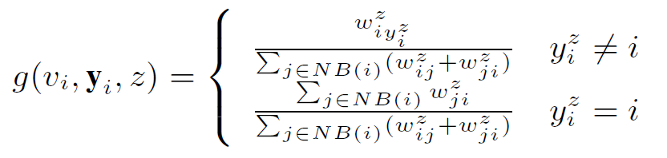
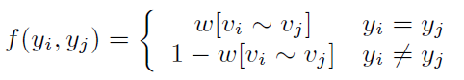
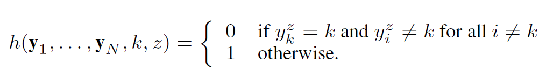
How to define (topical) feature functions?
similarity
Node feature function
Edge feature function
Global feature function
or simply binary

Slide 24
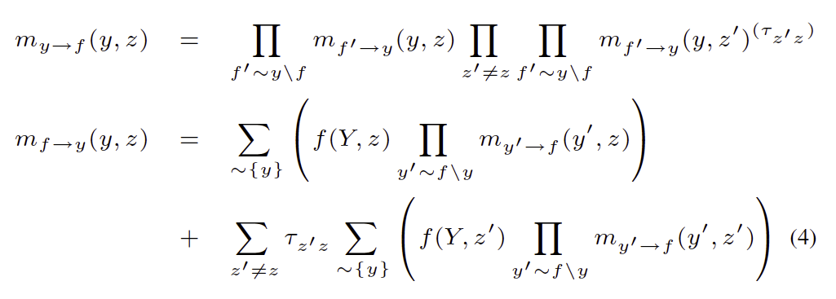
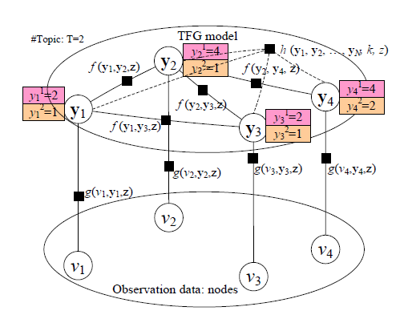
Model Learning Algorithm
Sum-product:
- Low efficiency!
- Not easy for distributed learning!

Slide 25
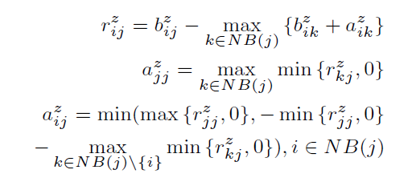
New TAP Learning Algorithm
1. Introduce two new variables r and a, to replace the original message m.
2. Design new update rules:
m_{ij}
[1] Jie Tang, Jimeng Sun, Chi Wang, and Zi Yang. Social Influence Analysis in Large-scale Networks. In KDD, pages 807-816, 2009.

Slide 26
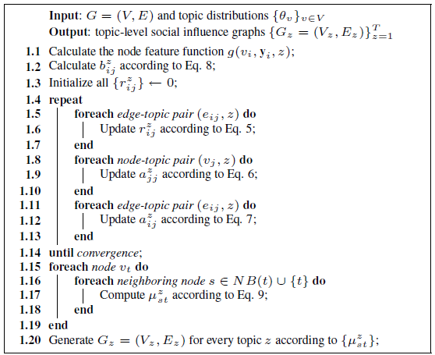
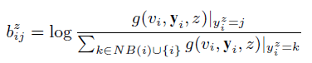
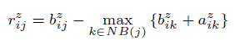
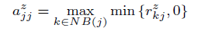
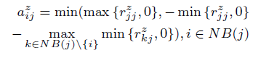
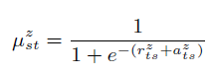
The TAP Learning Algorithm

Slide 27
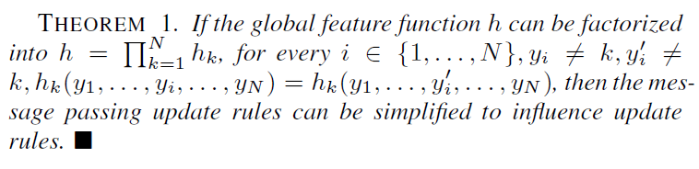
Distributed TAP Learning
Map-Reduce
Map: (key, value) pairs
e_{ij} /a_{ij} → e_{i*} /a_{ij}; e_{ij} /b_{ij} → e_{i*} /b_{ij}; e_{ij} /r_{ij} → e_{*j} /r_{ij} .
Reduce: (key, value) pairs
e_{ij} / * → new r_{ij}; e_{ij}/* → new a_{ij}
For the global feature function

Slide 28
Experiments
Data set: (http://arnetminer.org/lab-datasets/soinf/)
Evaluation measures
CPU time
Case study
Application
Data set | #Nodes | #Edges
Coauthor | 640,134 | 1,554,643
Citation | 2,329,760 | 12,710,347
Film (Wikipedia) | 18,518 films 7,211 directors 10,128 actors 9,784 writers | 142,426

Slide 29
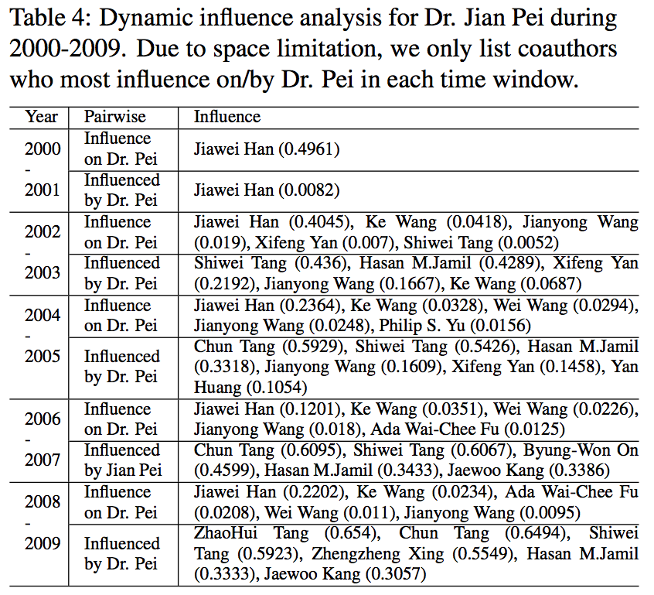
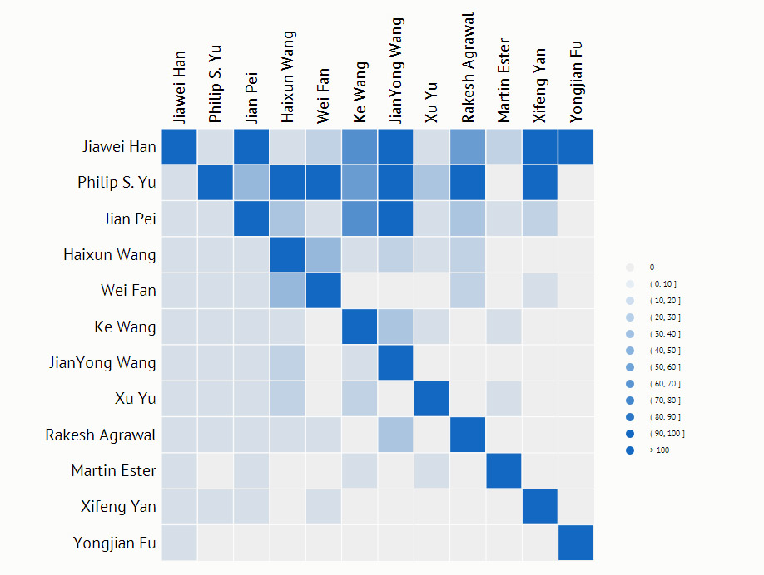
Social Influence Sub-graph on “Data mining”
On “Data Mining” in 2009

Slide 30
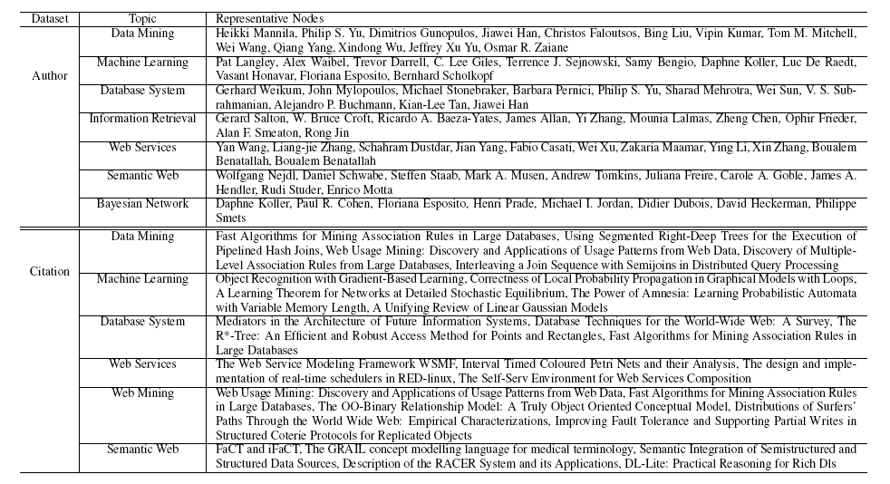
Results on Coauthor and Citation

Slide 31
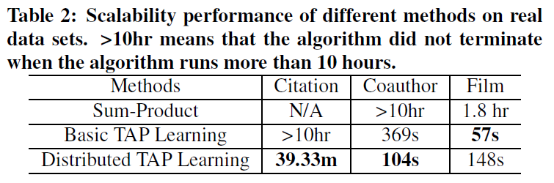
Scalability Performance

Slide 32
Speedup results
Speedup vs. #Computer nodes
Speedup vs. Dataset size

Slide 33
Still Challenges
How to model influence at different granularities?

Slide 34
Q1: Conformity Influence
I love Obama
Positive
Negative
3. Group conformity
Obama is fantastic
Obama is great!
1. Peer influence
2. Individual
[1] Jie Tang, Sen Wu, and Jimeng Sun. Confluence: Conformity Influence in Large Social Networks. In KDD’13, 2013.

Slide 35
Conformity Influence Definition
Three levels of conformities
Individual conformity
Peer conformity
Group conformity
Notes:
Our goal is to study how a user’s behavior conforms to her peer friends and the communities (groups) that she belongs to. In this work, we define three levels of conformities respectively from the aspect of individual, peer relationship, and group.

Slide 36
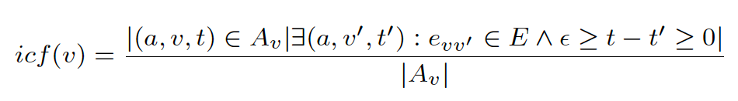
Individual Conformity
The individual conformity represents how easily user v’s behavior conforms to her friends
A specific action performed by user v at time t
Exists a friend v′ who performed the same action at time t’′
All actions by user v
Notes:
The individual conformity is defined as the ratio between the number of actions for which we have evidence that the user v conforms to one of her friends v′, over the total number of actions performed by user v.

Slide 37
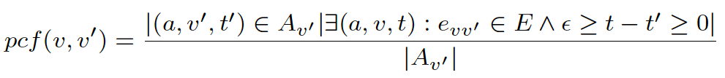
Peer Conformity
The peer conformity represents how likely the user v’s behavior is influenced by one particular friend v′
A specific action performed by user v′ at time t′
User v follows v′ to perform the action a at time t
All actions by user v′
Notes:
The peer conformity is defined as the ratio between the number of actions for which we have evidence that the user v conforms to her friend v′ , over the total number of actions performed by the friend v′

Slide 38
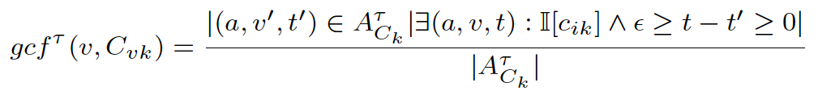
Group Conformity
The group conformity represents the conformity of user v’s behavior to groups that the user belongs to.
τ-group action: an action performed by more than a percentage τ of all users in the group C_{k}
User v conforms to the group to perform the action a at time t
A specific τ-group action
All τ-group actions performed by users in the group C_{k}
Notes:
To begin with, we first define the τ -group action as the action that was performed by more than a percentage τ of all users in the community (group) Ck. Given this, we define the group conformity as follows:
The group conformity is then defined as the ratio between the number of actions for which we have evidence that the user v conforms to the group, over the total number of τ -group actions performed by users in the group Ck,
Please note that a user may be involved into more than one groups, thus has different conformity degrees in the different groups.

Slide 39
Confluence —A conformity-aware factor graph model
Group conformity factor function
Random variable y: Action
Peer conformity factor function
Individual conformity factor function
Notes:
An example is illustrated in Figure 2. In the input network, user v1 belongs to three groups C1, C2, and C3, thus in the constructed factor graph, its corresponding latent variable y1 is connected to three group conformity factors (e.g., g(y1, gcf(v1,C1))). User v1 has four friends in the input network, thus four peer conformity factors in the factor graph model. We also define an individual conformity factor for each user.

Slide 40
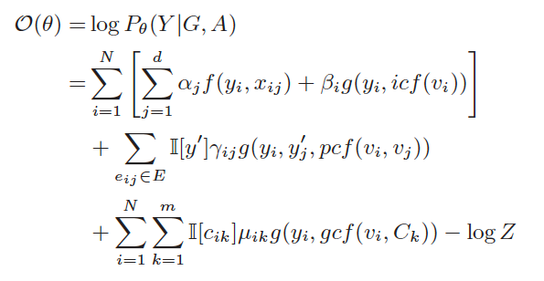
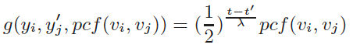
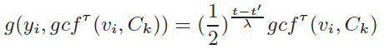
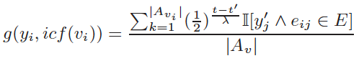
Model Instantiation
Individual conformity factor function
Peer conformity factor function
Group conformity factor function
Notes:
Based on the theory of factor graph model, we can define the following log-likelihood objective function. The decay factor decays
the peer conformity exponentially over time, with the half-life, λ, serving as a tunable parameter.
Besides the conformity actors, we use factor function f(yi, xij) to capture the correlation between the user’s attribute xij and user’s action.
Finally, learning the model is going to estimate the unkown parameters.

Slide 41
Distributed Learning
Master
Global update
Slave
Compute local gradient via random sampling
Graph Partition by Metis
Master-Slave Computing
Notes:
As real social network may contain millions of users, it’s important for the learning algorithm to scale up well with large networks.
So we developed a distributed learning algorithm. The gradient descent learning algorithm can be viewed as two steps:
First, compute the gradient via loopy belief propagation. Second, optimize the parameters with gradient descents.
In these two steps, the Gradient computation step is the bottleneck. Therefore, we developed a distributed loopy belief propagation. [Click]
It’s based on MPI, using master-slave architecture.
Specifically, we partition the graphical model into P sub-graphs, and edges across sub-graphs are discarded.
In each step, we calculate the gradient information in each subgraph, and accumulate the information in master node.
// partition strategy is important.
// animation.
// random partition不好，这也是一个challenge
// Clustering based
// 这个算法是什么？ 人可能问。
// 要partition ，partitioned relative same number of nodes。 Load balance
// 多介绍一下METIS

Slide 42



Distributed Model Learning
Unknown parameters to estimate
(1) Master
(2) Slave
(3) Master
Notes:
Learning the Confluence model is to estimate the unknown parameters

Slide 43

Model Network Dynamics
Time t
How to model dynamics in social networks?
How to distinguish influence from other social factors?
John

Slide 44

Social Influence & Action Modeling^{[1]}
Action: Who will come to attend MLA’14?
Influence
1
Correlation
Time t+1
3
Time t
John
John
Action bias
4
Personal attributes:
Always watch news
Enjoy sports
….
Dependence
2
[1] C. Tan, J. Tang, J. Sun, Q. Lin, and F. Wang. Social action tracking via noise tolerant time-varying factor graphs. In KDD’10, pages 807–816, 2010.
Notes:
To predict users’ actions, we need to consider complex factors. What information we have, we have a dynamic social network, and also attributes of his own. Intuitively, what factors we need to consider? First, the influence from his friends, second, he will keep the same action or attitude as himself, we call it dependence. Third, correlation between neighbours. Finally, personal interests.

Slide 45


A Discriminative Model: NTT-FGM
Influence
Correlation
Personal attributes
Dependence
Continuous latent action state
Action
Personal attributes
Notes:
The model we propose is as the graph shows. This graph shows a three-stage social network. We first add a continuous latent state for each user’s action state. And the factors are all defined according to the latent state. First we user action bias factor to consider the noise in users’ actions. And the influence factor denotes the influence from the past. Finally correlation factor defines the correlation between users and also personal interests. For the action bias factor, we have two option to choose for binary actions: bernoulli and Gaussian. Gaussian can be extended to continuous actions. So we choose Gaussian in our model for potential extension.

Slide 46



Model Instantiation
How to estimate the parameters?
Notes:
The correlation factor can be naturally modeled in a Markov random field.

Slide 47

Model Learning—Two-step learning
[1] C. Tan, J. Tang, J. Sun, Q. Lin, and F. Wang. Social action tracking via noise tolerant time-varying factor graphs. In KDD’10, pages 807–816, 2010.
Notes:
We employ an EM-style algorithm to train the model. This is the algorithm. Due to the time limit, if you are interested in the algorithm, we can discuss offline.

Slide 48





Learning Algorithm Details
Integration of Z (conditioned on α>0, β>0, λ>0)
Transform Z into a form of multivariate Gaussian dist.
First term is easy, but the others are difficult
b=Xα NT-vector; X is a NT x d matrix by concatenating all time-varying attribute matrices
All coefficients of z
correlation
A is NT x NT matrix
Influence

Slide 49
Experiment
Data Set (http://arnetminer.org/stnt)
Baseline
SVM
wvRN (Macskassy, 2003)
Evaluation Measure:
Precision, Recall, F1-Measure
 | Action | Nodes | #Edges | Action Stats
Twitter | Post tweets on “Haiti Earthquake” | 7,521 | 304,275 | 730,568
Flickr | Add photos into favorite list | 8,721 | 485,253 | 485,253
Arnetminer | Issue publications on KDD | 2,062 | 34,986 | 2,960
Notes:
Finally, I will introduce the experiments. This is the data sets we used in the experiment, and the actions is the same as previously introduced. The baseline methods we use includes SVM, which uses the personal features combined with his neighbours, while wvRN is an algorithm proposed in 2003, which makes user of the graph information. The evaluation measure includes precision, recall and F1-measure.

Slide 50



Results with influence

Slide 51
Results with Conformity Influence — Four Datasets
Baselines
Support Vector Machine (SVM)
Logistic Regression (LR)
Naive Bayes (NB)
Gaussian Radial Basis Function Neural Network (RBF)
Conditional Random Field (CRF)
Evaluation metrics
Precision, Recall, F1, and Area Under Curve (AUC)
Network | #Nodes | #Edges | Behavior | #Actions
Weibo | 1,776,950 | 308,489,739 | Post a tweet | 6,761,186
Flickr | 1,991,509 | 208,118,719 | Add comment | 3,531,801
Gowalla | 196,591 | 950,327 | Check-in | 6,442,890
ArnetMiner | 737,690 | 2,416,472 | Publish paper | 1,974,466
** All the datasets are publicly available for research.

Slide 52

Prediction Accuracy
t-test, p<<0.01

Slide 53

Effect of Conformity
Conﬂuence_{base} stands for the Conﬂuence method without any social based features
Conﬂuence_{base}+I stands for the Conﬂuence_{base} method plus only individual conformity features
Conﬂuence_{base}+P stands for the Conﬂuence_{base} method plus only peer conformity features
Conﬂuence_{base}+G stands for the Conﬂuence_{base} method plus only group conformity
Notes:
We further present an in-depth analysis of how different levels of conformities affect the performance of action prediction. It can be clearly seen that without the conformity based factors, the prediction performance drop significantly. Co-Author network is most predictable because the co-authorships are stable and predictable in general. Weibo and Flickr are the most difficult to predict because the user behavior is fairly autonomous and independent. Conformity has most significant prediction impact on Gowalla, which suggests conformity plays an important role in geospatial and mobile applications in social networks. By incorporating the conformity features, significant improvements (+20-30%) over the prediction performance can be obtained on Gowalla. Confluencebase+I (or +P or +G) respectively indicates that we respectively add individual conformity features (or peer conformity features or group conformity features) into the Confluencebase method. By incorporating each type of conformity factors, we observe clear improvement compared to the Confluencebase method. We can also see that on all the four data sets, the group conformity is more important than the other two types of conformities. This makes sense, as in most cases conformity is a group phenomenon rather than an individual behavior

Slide 54


Scalability performance
Achieve ∼ 9×speedup with 16 cores
Notes:
We now evaluate the scalability performance of the distributed learning algorithm on the four networks.
Figure 5 shows the speedup of the distributed algorithm with different number of computer nodes (2, 3, 6, 8, 10, 12, 14, 16 cores) used. The speedup curve is close to the perfect line at the beginning. the distributed learning algorithm can still achieve 9x speedup with 16 cores.

Slide 55
Roadmap
User-level
Social Tie
Network
tie
Social role
Influence
- Emotion
- Demographics
- Social Influence
- Conformity
- Learning from users
- Learning in social streaming

Slide 56

Evolving Networks
E.g., in merely one Tencent game (QQ Speed), users generated 20B (200亿) activities per month
Network structure and content are changing over time and the networked data arrives in a streaming fashion

Slide 57

Problem
A basic question: how to effectively incorporate collective intelligence to help big data prediction in the networked data stream?

Slide 58
Modeling Networked Data
The Basic Model: Markov Random Field
Given the graph , we can write the energy as
True labels of queried instances
The energy associated with the edge
The energy defined for instance
Notes:
In this work, we use undirected graphical model, also known as markov random field, to model the networked data. Given a time dependent graph, we can write the energy as the sum of energy on edges and energy defined for instances.

Slide 59

Our Solution: Structural Variability
Properties of Structural Variability
Monotonicity. Suppose and are two sets of instance labels. Given , if , then we have
Normality. If , we have
The structural variability will not increase as we label more instances in the MRF.
If we label all instances in the graph, we incur no structural variability at all.
Zhilin Yang, Jie Tang, and Yutao Zhang. Active Learning for Streaming Networked Data. In CIKM'14.

Slide 60

Structural Variability vs. Centrality
Properties of Structural Variability
3. Centrality
Under certain circumstances, minimizing structural variability leads to querying instances with high network centrality.

Slide 61


Streaming Active Query
Decrease Function
We define a decrease function for each instance
Structural variability before querying y_i
Structural variability after querying y_i
The second term is in general intractable. We estimate the second term by expectation
The true probability
We approximate the true probability by
Notes:
To develop an active query algorithm, we want to measure the decrease in structural variability after an instance is queried. So we define a decrease function as the structural variability before query MINUS the structural variability after query. To compute the second term, we estimate the second term by taking expectation. To compute the true probability, we approximate it with an exponential linear function based on the current model.

Slide 62

Streaming Prediction Algorithm
Learning with labeled instances
Select new instances to query

Slide 63
Enhancement by Network Sampling
Basic Idea
Maintain an instance reservoir of a fixed size, and update the reservoir sequentially on the arrival of streaming data.
Which instances to discard when the size of the reservoir is exceeded?
Simply discard early-arrived instances may deteriorate the network correlation. Instead, we consider the loss of discarding an instance in two dimensions:
Spatial dimension: the loss in a snapshot graph based on network correlation deterioration
Temporal dimension: integrating the spatial loss over time
Notes:
In real world problems, it is inefficient to store all the data for updating the MRF model. We propose a network sampling algorithm to enhance the performance so that we can handle large scale datasets. The basic idea is to maintain an instance reservoir of a fixed size, and update the reservoir sequentially on the arrival of streaming data. When a new instance arrives, the reservoir size limit may be exceeded. We need to discard an instance from the reservoir. We consider the loss of discarding an instance in two dimensions. For the spatial dimension, we measure the loss in a snapshot graph based on network correlation deterioration. For the temporal dimension, we integrate the spatial loss over time.

Slide 64


Enhancement by Network Sampling
Spatial Dimension
Use dual variables as indicators of network correlation.
The violation for instance can be written as
Then the spatial loss is
Measure how much the optimization constraint is violated after removed the instance
Intuition
Dual variables can be viewed as the message sent from the edge factor to each instance
The more serious the optimization constraint is violated, the more we need to adjust the dual variables

Slide 65


Enhancement by Network Sampling
Temporal Dimension
The streaming network is evolving dynamically, we should not only consider the current spatial loss.
To proceed, we assume that for a given instance , dual variables of its neighbors have a distribution with an expectation and that the dual variables are independent.
We obtain an unbiased estimator for
Integrating the spatial loss over time, we obtain
Suppose edges are added according to preferential attachment [2], the loss function is written as

Slide 66


Enhancement by Network Sampling
The algorithm
At time , we receive a new datum from the data stream, and update the graph.
If the number of instances exceed the reservoir size, we remove the instance with the least loss function and its associated edges from the MRF model.
Interpretation
The first term
Enables us to leverage the spatial loss function in the network.
Instances that are important to the current model are also likely to remain important in the successive time stamps.
The second term
Instances with larger are reserved.
Our sampling procedure implicitly handled concept drift, because later-arrived instances are more relevant to the current concept [28].

Slide 67
Experiments—Datasets
Weibo [26] is the most popular microblogging service in China.
View the retweeting flow as a data stream.
Predict whether a user will retweet a microblog.
3 types of edge factors: friends; sharing the same user; sharing the same tweet
Slashdot is an online social network for sharing technology related news.
Treat each follow relationship as an instance.
Predict “friends” or “foes”.
3 types of edge factors: appearing in the same post; sharing the same follower; sharing the same followee.
IMDB is an online database of information related to movies and TVs.
Each movie is treated as an instance.
Classify movies into categories such as romance and animation.
Edges indicate common-star relationships.
ArnetMiner [19] is an academic social network.
Each publication is treated as an instance.
Classify publications into categories such as machine learning and data mining.
Edges indicate co-author relationships.

Slide 68

Experiments—Datasets

Slide 69


Experiments—Results

Slide 70

Experiments—Performance of Hybrid Approach
We fix the labeling rate and reservoir size, and compare different combinations of active query algorithms and network sampling algorithms.
Active Query
- MV: minimum variability
- VU: Variable Uncertainty [29]
- FD: Feedback Driven [5]
- RAN: Random
Sampling
- ML: minimum loss
- SW: Sliding Window
- PIES: Partially induced sampling [1]
- MD: Minimum Degree

Slide 71
Let us talk about some “Social Good”

Slide 72






Big Data Analytics in MOOC
108 partners
633 courses
7.1 million users
100+ courses
~300,000 users
Chinese EDU association
50+ partners
160+ courses
2.1 million users
host >900 courses
millions of users
~10 partners
40+ courses
1.6 million users
……
Notes:
Online courses are not really new, but they have reached an unprecedented scale since late 2011.
Several organizations: Coursera,edX and Udacity have released MOOCs, which have attracted more than 100,000 students per course. And also the number of courses grows up more than 100 courses.

Slide 73


XuetangX.com
Develop based on OpenEdX
XuetangX has some new functionalities such as: internationalization, new video player, course search, equation editor, auto grading, etc.

Slide 74

In Service
Support ~100 Tsinghua MOOCs simultaneously with edX
Principles of Electric Circuits; History of Chinese Architecture; Data Structure; Historical Relic Treasures and Cultural China; Financial Analysis and Decision Making
Partners’ courses
MIT: Circuits and Electronics
UC Berkeley: Cloud Computing and Software Engineering
Peking University: Principles and Practice of Computer Aided Translation
Support 2 Tsinghua SPOCs
C++ Programming by Prof. ZHENG, Li for 93 students
Cloud Computing and Soft Engineering by Prof. XU, Wei for 35 students

Slide 75

User enrolment in the past months

Slide 76
Rich tracking logs of student behaviors
The huge amount of data available in MOOC offers a unique opportunity for understanding student behavior
Such logs include: watch video, homework, forum, etc.
Item | Number
Users | 88,112
Courses | 11
Logs | ~60M activities
Date span | 2013/09/28- 2014/07/12

Slide 77
One particular question
One fact: 76,215 users and only 3%-6% received the certificates
An interesting question is:
Who finally received the certificates?
Does social influence have any effects on users’ behaviors?

Slide 78

Age+Education vs. Certificate

Slide 79

Age+Gender vs. Certificate

Slide 80

Gender+Location vs. Certificate

Slide 81

Forum vs. Certificate

Slide 82

Friend Influence vs. Certificate

Slide 83

Deadline vs. Certificate

Slide 84
Can we predict who will/could receive the certificate
Given behavior log data by all users in the MOOC system,
Predict whether a user will finally graduate and receive the certificate of a specific course.

Slide 85
Factorization Machines
The prediction of feature vector x_{i}:
and the corresponding objective function:

Slide 86
Preliminary Results
Method | Features | AUC | Precision | Recall | F1
Factorization Machines | Demographics | 90.80 | 5.91 | 45.24 | 9.89
 | + Social Influence | 98.28 | 82.90 | 89.89 | 85.53
SVM | Demographics | 84.36 | 5.54 | 42.31 | 9.81
 | + Social influence | 98.49 | 85.90 | 80.85 | 82.27
* SVM is a state-of-the-art algorithm for classification/prediction. We use it as the baseline method in our experiments.

Slide 87
Conclusions
Big online data provide unprecedented opportunities to study user behavior
User behavior modeling and prediction
Social influence
Network dynamics
Data modeling for the MOOC data
Future work
Unified framework for modeling macro, meso, and micro network phenomena

Slide 88
Related Publications
Jie Tang, Jimeng Sun, Chi Wang, and Zi Yang. Social Influence Analysis in Large-scale Networks. In KDD’09, pages 807-816, 2009.
Chenhao Tan, Jie Tang, Jimeng Sun, Quan Lin, and Fengjiao Wang. Social action tracking via noise tolerant time-varying factor graphs. In KDD’10, pages 807–816, 2010.
Chenhao Tan, Lillian Lee, Jie Tang, Long Jiang, Ming Zhou, and Ping Li. User-level sentiment analysis incorporating social networks. In KDD’11, pages 1397–1405, 2011.
Jie Tang, Sen Wu, and Jimeng Sun. Confluence: Conformity Influence in Large Social Networks. In KDD’13, pages 347-355, 2013.
Yuxiao Dong, Yang Yang, Jie Tang, Yang Yang, Nitesh V. Chawla. Inferring User Demographics and Social Strategies in Mobile Social Networks. In KDD’14, 2014.
Jing Zhang, Biao Liu, Jie Tang, Ting Chen, and Juanzi Li. Social Influence Locality for Modeling Retweeting Behaviors. In IJCAI'13, pages 2761-2767, 2013.
Jing Zhang, Jie Tang, Honglei Zhuang, Cane Wing-Ki Leung, and Juanzi Li. Role-aware Conformity Influence Modeling and Analysis in Social Networks. In AAAI'14, 2014.
Jie Tang, Jing Zhang, Limin Yao, Juanzi Li, Li Zhang, and Zhong Su. ArnetMiner: Extraction and Mining of Academic Social Networks. In KDD’08, pages 990-998, 2008.
Tiancheng Lou and Jie Tang. Mining Structural Hole Spanners Through Information Diffusion in Social Networks. In WWW'13, pages 837-848, 2013.
Lu Liu, Jie Tang, Jiawei Han, and Shiqiang Yang. Learning Influence from Heterogeneous Social Networks. In DMKD, 2012, Volume 25, Issue 3, pages 511-544.
Tiancheng Lou, Jie Tang, John Hopcroft, Zhanpeng Fang, Xiaowen Ding. Learning to Predict Reciprocity and Triadic Closure in Social Networks. In TKDD, Vol 7(2), 2013.
Jimeng Sun and Jie Tang. A Survey of Models and Algorithms for Social Influence Analysis. Social Network Data Analytics, Aggarwal, C. C. (Ed.), Kluwer Academic Publishers, pages 177–214, 2011.
Jie Tang and Jimeng Sun. Models and Algorithms for Social Influence Analysis. In WWW’14. (Tutorial)

Slide 89
References
S. Milgram. The Small World Problem. Psychology Today, 1967, Vol. 2, 60–67
J.H. Fowler and N.A. Christakis. The Dynamic Spread of Happiness in a Large Social Network: Longitudinal Analysis Over 20 Years in the Framingham Heart Study. British Medical Journal 2008; 337: a2338
R. Dunbar. Neocortex size as a constraint on group size in primates. Human Evolution, 1992, 20: 469–493.
R. M. Bond, C. J. Fariss, J. J. Jones, A. D. I. Kramer, C. Marlow, J. E. Settle and J. H. Fowler. A 61-million-person experiment in social influence and political mobilization. Nature, 489:295-298, 2012.
http://klout.com
Why I Deleted My Klout Profile, by Pam Moore, at Social Media Today, originally published November 19, 2011; retrieved November 26 2011
S. Aral and D Walker. Identifying Influential and Susceptible Members of Social Networks. Science, 337:337-341, 2012.
J. Ugandera, L. Backstromb, C. Marlowb, and J. Kleinberg. Structural diversity in social contagion. PNAS, 109 (20):7591-7592, 2012.
S. Aral, L. Muchnik, and A. Sundararajan. Distinguishing influence-based contagion from homophily-driven diffusion in dynamic networks. PNAS, 106 (51):21544-21549, 2009.
J. Scripps, P.-N. Tan, and A.-H. Esfahanian. Measuring the effects of preprocessing decisions and network forces in dynamic network analysis. In KDD’09, pages 747–756, 2009.
Rubin, D. B. 1974. Estimating causal effects of treatments in randomized and nonrandomized studies. Journal of Educational Psychology 66, 5, 688–701.
http://en.wikipedia.org/wiki/Randomized_experiment

Slide 90
References(cont.)
A. Anagnostopoulos, R. Kumar, M. Mahdian. Influence and correlation in social networks. In KDD’08, pages 7-15, 2008.
L. Page, S. Brin, R. Motwani, and T. Winograd. The pagerank citation ranking: Bringing order to the web. Technical Report SIDL-WP-1999-0120, Stanford University, 1999.
G. Jeh and J. Widom. Scaling personalized web search. In WWW '03, pages 271-279, 2003.
G. Jeh and J. Widom, SimRank: a measure of structural-context similarity. In KDD’02, pages 538-543, 2002.
A. Goyal, F. Bonchi, and L. V. Lakshmanan. Learning influence probabilities in social networks. In WSDM’10, pages 207–217, 2010.
P. Domingos and M. Richardson. Mining the network value of customers. In KDD’01, pages 57–66, 2001.
D. Kempe, J. Kleinberg, and E. Tardos. Maximizing the spread of influence through a social network. In KDD’03, pages 137–146, 2003.
J. Leskovec, A. Krause, C. Guestrin, C. Faloutsos, J. VanBriesen, and N. Glance. Cost-effective outbreak detection in networks. In KDD’07, pages 420–429, 2007.
W. Chen, Y. Wang, and S. Yang. Efficient influence maximization in social networks. In KDD'09, pages 199-207, 2009.
E. Bakshy, D. Eckles, R. Yan, and I. Rosenn. Social influence in social advertising: evidence from field experiments. In EC'12, pages 146-161, 2012.
A. Goyal, F. Bonchi, and L. V. Lakshmanan. Discovering leaders from community actions. In CIKM’08, pages 499–508, 2008.
N. Agarwal, H. Liu, L. Tang, and P. S. Yu. Identifying the influential bloggers in a community. In WSDM’08, pages 207–217, 2008.

Slide 91
References(cont.)
E. Bakshy, B. Karrer, and L. A. Adamic. Social influence and the diffusion of user-created content. In EC ’09, pages 325–334, New York, NY, USA, 2009. ACM.
P. Bonacich. Power and centrality: a family of measures. American Journal of Sociology, 92:1170–1182, 1987.
R. B. Cialdini and N. J. Goldstein. Social influence: compliance and conformity. Annu Rev Psychol, 55:591–621, 2004.
D. Crandall, D. Cosley, D. Huttenlocher, J. Kleinberg, and S. Suri. Feedback effects between similarity and social influence in online communities. In KDD’08, pages 160–168, 2008.
P. W. Eastwick and W. L. Gardner. Is it a game? evidence for social influence in the virtual world. Social Influence, 4(1):18–32, 2009.
S. M. Elias and A. R. Pratkanis. Teaching social influence: Demonstrations and exercises from the discipline of social psychology. Social Influence, 1(2):147–162, 2006.
T. L. Fond and J. Neville. Randomization tests for distinguishing social influence and homophily effects. In WWW’10, 2010.
M. Gomez-Rodriguez, J. Leskovec, and A. Krause. Inferring Networks of Diffusion and Influence. In KDD’10, pages 1019–1028, 2010.
M. E. J. Newman. A measure of betweenness centrality based on random walks. Social Networks, 2005.
D. J. Watts and S. H. Strogatz. Collective dynamics of ’small-world’ networks. Nature, pages 440–442, Jun 1998.
J. Sun, H. Qu, D. Chakrabarti, and C. Faloutsos. Neighborhood formation and anomaly detection in bipartite graphs. In ICDM’05, pages 418–425, 2005.

Slide 92
Thank you！
Collaborators: John Hopcroft, Jon Kleinberg, Chenhao Tan (Cornell)
Jiawei Han and Chi Wang (UIUC)
Tiancheng Lou (Google) Jimeng Sun (IBM)
Wei Chen, Ming Zhou, Long Jiang (Microsoft)
Jing Zhang, Zhanpeng Fang, Zi Yang, Sen Wu, Jia Jia (THU)
Jie Tang, KEG, Tsinghua U, http://keg.cs.tsinghua.edu.cn/jietang
Download all data & Codes, http://arnetminer.org/download

Slide 93
“A mathematician is a device for turning coffee into theorems”
Alfréd Rényi
“If I feel unhappy, I do mathematics to become happy. If I am happy, I do mathematics to keep happy.”
Alfréd Rényi

